Slide 1

Superstore Executive Dashboard
Santhosh Kumar Alaparthi

Slide 2
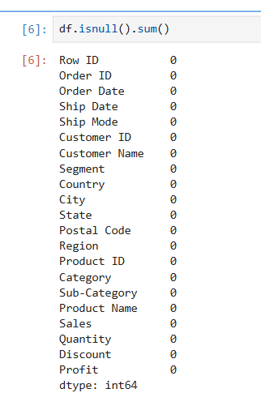
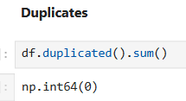

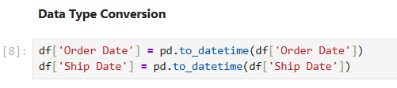
PREPROCESSING

Slide 3
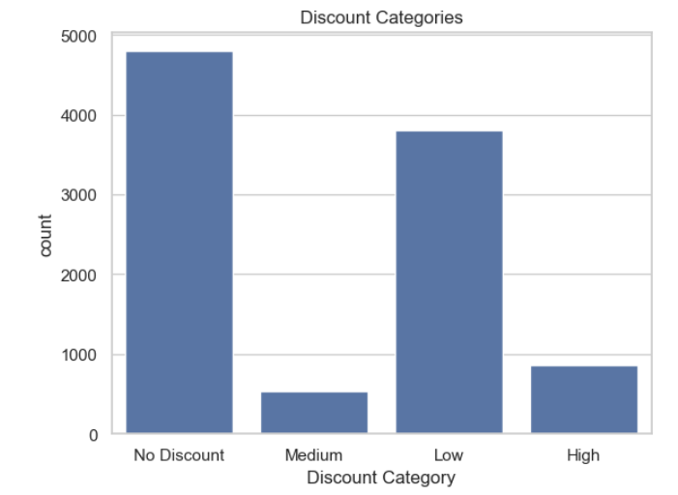
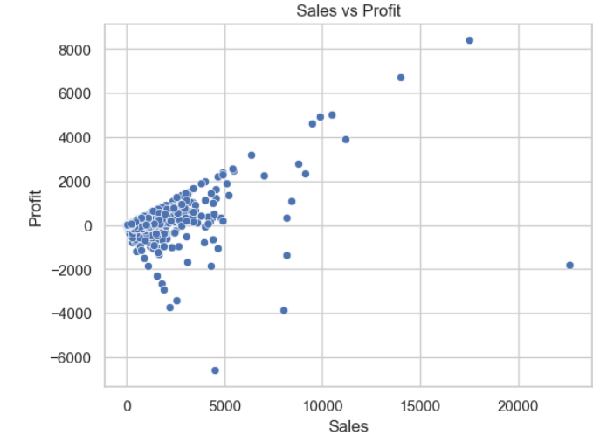
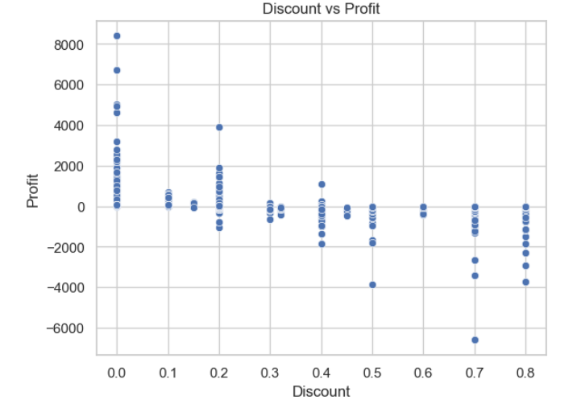
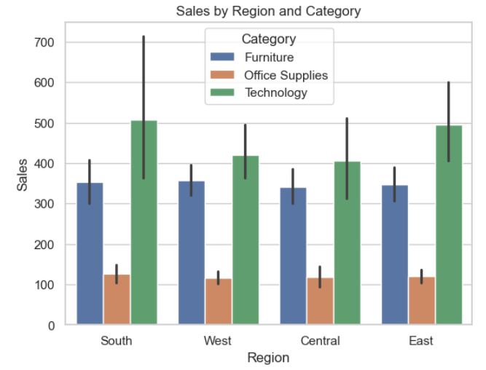
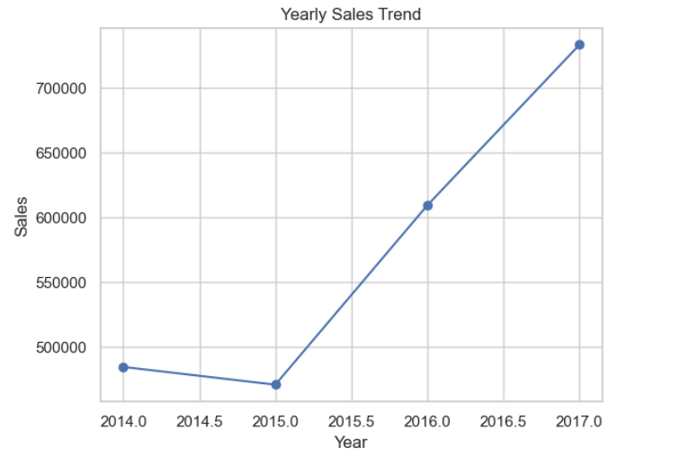
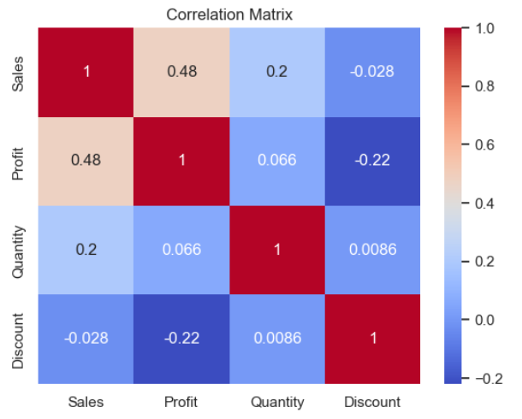
EDA

Slide 4
APPLICATION
https://2014-2017salesdashboard.shinyapps.io/superstore_dashboard11/

Slide 5
ADVANTAGES
Clear Structure & Navigation The dashboard is divided into focused sections (Geography, Product Mix, Financials, Time Trends), making it easy to explore different aspects of the data.
Use of Appropriate Visualisations Charts such as bar charts, line charts, and scatter plots are selected based on the type of data, improving clarity and understanding.
Interactive Filtering Users can dynamically filter data by year, region, category, and state, enabling customised analysis.
Comprehensive Analysis Covers multiple perspectives including sales, profit, products, and trends in a single application.
User-Friendly Design Simple layout and clear visuals allow even non-technical users to interpret the data

Slide 6
IMPROVEMENTS
Limited Advanced Analytics The dashboard focuses mainly on descriptive analysis and does not include predictive or forecasting models.
Performance Limitations With larger datasets, the application may experience slower response times.
Static Dataset The data is not updated in real-time, which limits its use for live decision-making.

Slide 7
FUTURE WORK
Integration of Predictive Analytics Add machine learning models to forecast sales and profit trends.
Real-Time Data Integration Connect the dashboard to live databases for up-to-date insights.
Enhanced Interactivity Allow users to create custom views and advanced drill-down analysis.
Performance Optimisation Improve speed and scalability for handling larger datasets.

Slide 8
THANK YOU

